Slide 1


Project Introduction
Energy Communities Excellence Hubs: Catalyzing Energy Innovation Ecosystems
Prof. Dr. Ozan Erdinç
Yildiz Technical University – Department of Electrical Engineering
oerdinc@yildiz.edu.tr; ozanerdinc@gmail.com

Slide 2
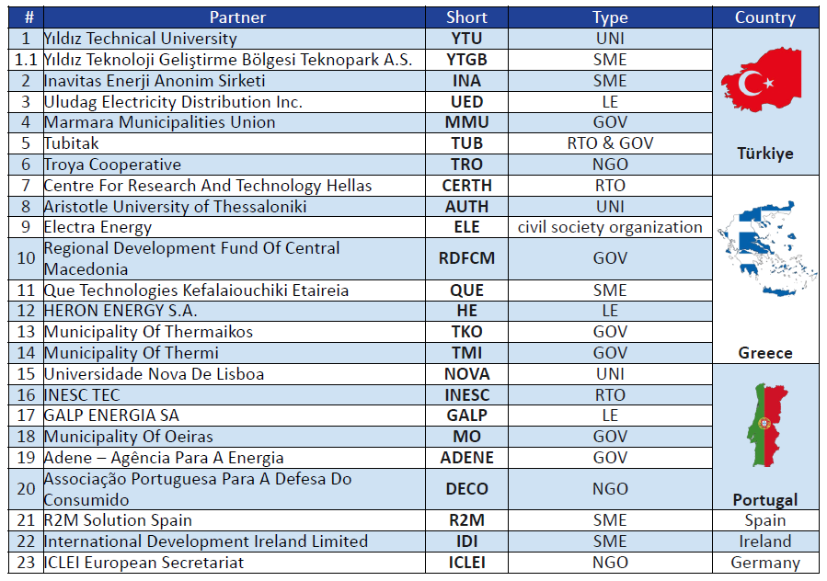
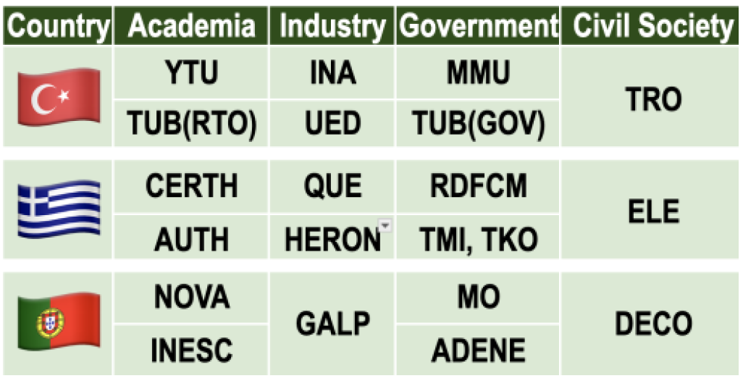
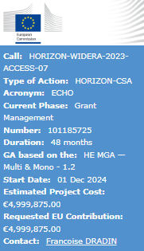
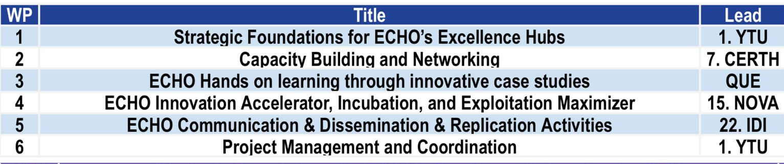
ECHO at a Glance…
Quintuple Helix Approach
3 Hubs,
24 Part.,
6 WPs,
48 months,
5 million Euros!

Slide 3
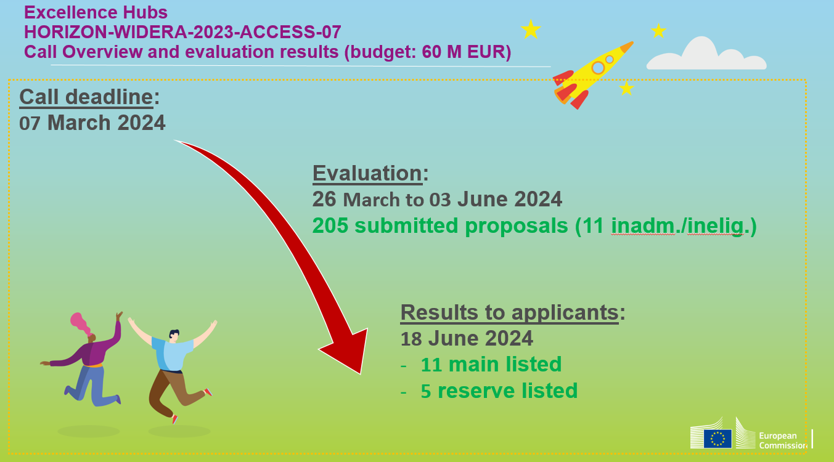
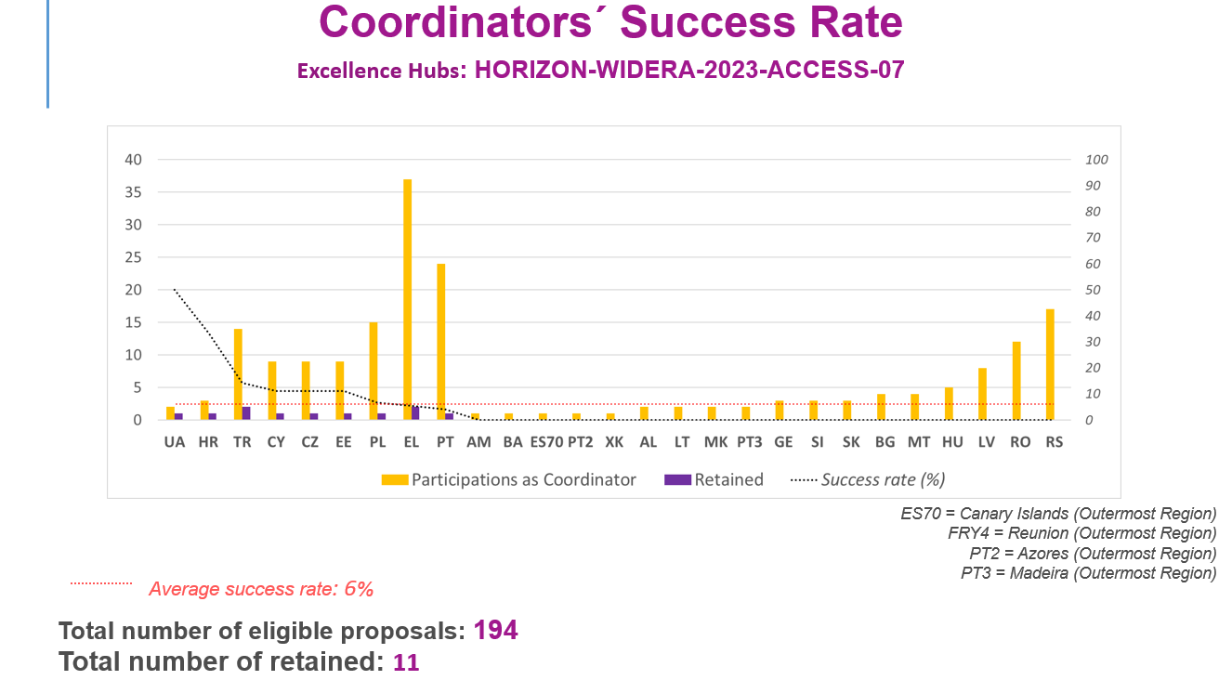
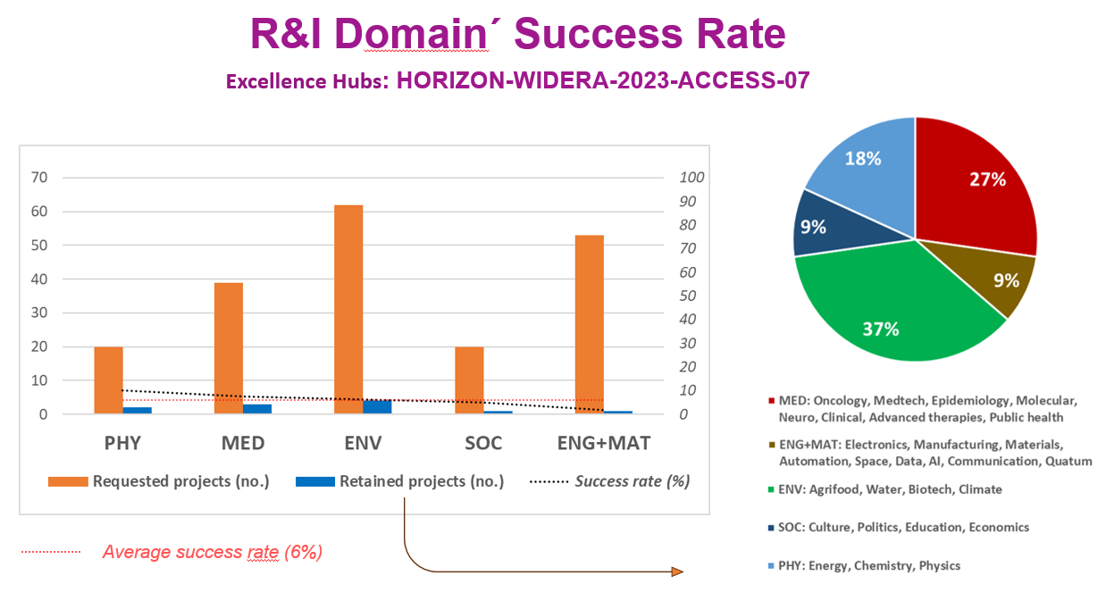
Our Success!

Slide 4
Overall Objectives & Project Milestones
Objectives
O1 — Strategic Foundations & Hub Launch: Build the strategic foundations and launch ECHO’s transformative Excellence Hubs in Türkiye (ECHO-TR), Greece (ECHO-EL) and Portugal (ECHO-PT).
O2 — Stakeholder Empowerment: Empower diverse stakeholders with the knowledge, skills and connections to drive successful Energy Community development and innovation within the ECHO Excellence Hubs.
O3 — Pilot Energy Communities: Partner with Energy Communities at varying maturity levels to co-pilot innovative services, support community formation and identify regulatory gaps.
O4 — Innovation Ecosystems & Technology Transfer: Foster innovation ecosystems and technology transfer across the three Excellence Hubs.
O5 — Communication & Dissemination: Execute a comprehensive, stakeholder-driven dissemination and communication plan using multilingual strategies for targeted impact on policymakers, investors, energy-sector stakeholders and civil society.
Reporting Periods & Payment Schedule
RP1 M1–M15 (01 Dec 2024 – 28 Feb 2026)
RP2 M16–M30 (01 Mar 2026 – 31 May 2027)
RP3 M31–M48 (01 Jun 2027 – 30 Nov 2028)
Milestones & Risks
17 milestones and 19 defined risks in total.

Slide 5
Work Package Structure (I) — WP1 – WP3
WP1 — Strategic Foundations for ECHO’s Excellence Hubs | Leader: YTU | M1–M36
T1.1 ECHO Needs & Opportunities Mapping (M1–M6)
T1.2 Building Strategic Excellence Hub Networks (M2–M8)
T1.3 Excellence Hub Benchmarking (M6–M12)
T1.4 From Hub Strategy to Launch (M8–M14)
T1.5 Strategy Feedback and Iteration (M12–M36)
Deliverables: D1.1 Hub Strategic Development & Benchmarking Report (M12, PU) | D1.2 Hub Implementation & Evolution Framework (M36, PU)
WP2 — Capacity Building and Networking | Leader: CERTH | M1–M48
T2.1 ECHO Training Programme Development (M1–M18)
T2.2 ECHO Training Activities Organisation (M12–M48)
T2.3 ECHO Networking Platform Establishment (M6–M48)
T2.4 ECHO Expert Collaboration Programme (M10–M48)
T2.5 ECHO Training Monitoring and Evaluation (M24–M48)
Deliverables: D2.1 Knowledge Hub & Training Programme (M18, PU) | D2.2 Collaborative Network & Expert Integration (M48, PU) | D2.3 Training Effectiveness Report (M48, PU)
WP3 — Hands-on Learning through Innovative Case Studies | Leader: QUE | M3–M48
T3.1 Site Selection and Co-Development Planning (M3–M12)
T3.2 ECHO Service Integration and Support (M13–M30)
T3.3 Benchmarking and Participatory Insights (M18–M30)
T3.4 Cross-Site Learning and Community Exchange (M12–M42)
T3.5 Investment Models and Toolkit Design (M30–M48)
Deliverables: D3.1 Pilot Site Development & Integration Framework (M30, PU) | D3.2 Community Benchmarking & Learning Toolkit (M42, PU) | D3.3 Sustainable Investment & Toolkit Design (M48, PU)

Slide 6
Work Package Structure (II) — WP4 - WP6
WP4 — Innovation Incubation, Accelerator & Exploitation Maximiser | Leader: NOVA | M6–M48
T4.1 IP Assessment & Strategy (M6–M18)
T4.2 Technology Maturation and Incubation Launch (M12–M24)
T4.3 Incubation Kickstart (M18–M36)
T4.4 Mentorship and Commercialisation (M24–M48)
T4.5 Impact Optimisation (M36–M48)
Deliverables: D4.1 IP & Commercialisation Report (M36, PU) | D4.2 Incubation & Mentorship Programme (M48, PU) | D4.3 Policy Advocacy & Impact Report (M48, PU)
WP5 — Communication, Dissemination & Replication Activities | Leader: IDI | M1–M48
T5.1 Communication Strategy & Dissemination Plan Development (M1–M48)
T5.2 ECHO Branding and Digital Outreach (M1–M48)
T5.3 ECHO Quadruple Helix Engagement Toolbox (M1–M48)
T5.4 Participation & Collaboration with EU Energy Community Initiatives (M1–M48)
T5.5 ECHO Hubs Sustainability and Expansion Strategy (M24–M48)
Deliverables: D5.1 Communication & Branding Package (M4, PU) | D5.2 Stakeholder Engagement & Best Practices Toolkit (M18, PU) | D5.3 Hub Sustainability & Expansion Strategy (M48, PU) | D5.4 CDE Progress Report I (M24, PU) | D5.5 CDE Progress Report II (M48, PU)
WP6 — Project Management and Coordination | Leader: YTU | M1–M48
T6.1 Project Coordination — Administrative, Financial & Risk Management (M1–M48)
T6.2 Project, Data & Ethics Management Plan (M1–M48)
T6.3 Project Reporting (M1–M48)
Deliverables: D6.1 Project Management Plan (M2, SEN) | D6.2 Data & Ethics Management Plan (M4, PU) | D6.3 DMP Update I (M24, PU) | D6.4 DMP Update II (M48, PU)

