Slide 1
RENEWABLE ENERGY COOPERATIVES AUSTRALIA
MAY 2016
R. GARRY YOST

Slide 2
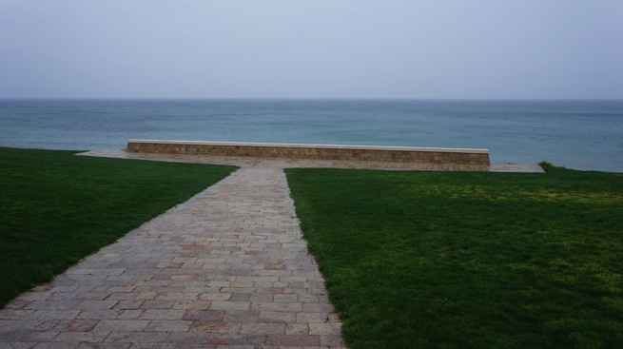
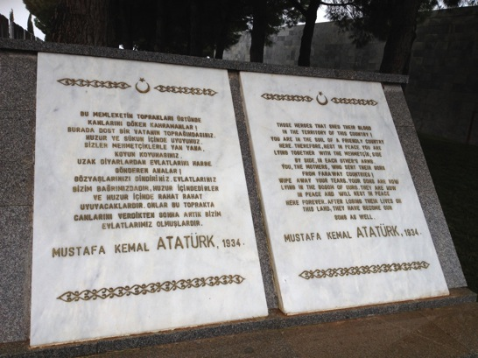
1. Before Renewable Energy, Gallipoli

Slide 3
2. Renewable Energy Systems - 1
Solar ( Solar PV (Photovoltaic) & Solar Heating)
Wind
Hydro
Geothermal (district heating & electricity)
Wave
Biomass/Biogas
All of these vary in scale and size Wind turbines for example are now pushing the boundaries of how we can lift them into position. A 1000 tonne crane is no longer big enough for a 5MW wind turbine.
The scale of Solar Power Plants has also increased and a 200MW solar plant is now a common occurrence in many parts of the world.
Hydro Electric energy is by far the oldest and arguably the cleanest renewable energy technology we have.
Geothermal is also very reliable, however it is very expensive to install.
Wave technology is still in its infancy, and in various forms with corrosion by the salt water its biggest enemy.

Slide 4
2. Renewable Energy Systems -2
All of These can then be broken down into either;
ON GRID or OFF GRID
Licensed – Unlicensed
ON Grid means that that you have the luxury of being connected to the national Electrical Network. You can BUY & SELL electricity from the Grid.
OFF Grid means that you have no luxury of a Grid connection, but you do have usually Batteries and/or a standby generator to provide energy when either the sun goes down or the wind stops blowing.
OFF Grid while it gives you a much higher degree of independence means that you need to be a bit more careful about your use of the energy available to you.

Slide 5
3. Tasmanian Community Wind Farm for Irrigation - 1
Some years ago the Tasmanian Government, after a very severe 100 + year type drought decided to embark on a very large water irrigation system which passed the “front gate” of every farm in the Central north of the island.
As you can imagine very few Farmers had their water dams “at their front gate”, and in fact they needed to pump the water a kilometre or three to where they and their livestock and crops needed it.
This presented both an;
A usually heavy up front cost to build the branch pipeline to get the water from the main irrigation system to where it was needed.
And an equally heavy cost of monthly and quarterly electricity bills.
As you know pumping water can be expensive.

Slide 6
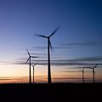
3. Tasmanian Community Wind Farm for Irrigation - 2
Obviously a Renewable Enerji solution was the answer!
That was when we came up with the idea of building a small scale wind farm which would be owned by a Co-operative or Unit Trust.
The Trust had 100 units and the value of one unit was equal to 100th of the total cost of the proposed wind farm.
The farm was a 5MW farm consisting of 10 x 500kW wind turbines.
The total cost of the farm was 10 million Australian dollars (20 million TL)
So as you can work out one unit was valued at AUD$100,000.
If one Farmer bought 4 units he paid AUS$400,000, a total of 25 Farmers bought between 2 and 6 units each depending on their power consumption.
At AUD$33.00 per hour for a 3 phase - 100kW water pump a Farmer could pay upwards of AUD$9,900 per month for electricity. Over 12 months this is AUD$118,800 per year for water pumping.

Slide 7
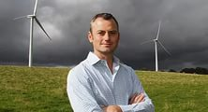
4. Daylesford Community Wind Farm
Another option is for “Community or village” ownership of Renewable Energy projects.
A very good friend of mine Simon Holmes a Court put together a small wind farm project just north west of Ballarat in a town called Daylesford.
The two Wind turbines were owned by some of the people of the own and the energy (money income) made was deducted pro rata from each individual’s electricity bill.
“Now, 1900 members - slightly more than half of them locals - jointly own the wind farm, in parcels of $1 shares ranging from $100 to $1.5 million (most are $1000-$5000). That raised $9.7 million and the rest of the $13.5 million project cost came from government grants and a bank loan”.

Slide 8
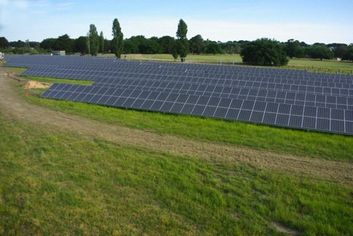
5. Ballarat Community Solar Farm
Another project, which I personally built, was the Community owned Ballarat Solar Farm.
This was 333kW Solar Park built adjacent the Ballarat Airport in Central Victoria.
Originally owned by the Ballarat Municipality and Origin Energy upon completion of it’s first full year of operation is converted into a Community Trust with 1,000 Unit holders.
Each Unit holder received an Annual payment from the Trust for the value of his or her share of energy produced during that year.

Slide 9
6. Çanakkale Example
Çanakkale Average windspeed 7,6 m/s
Income after expenses and maintenance was approximately AUD$4,565,000. So a Farmer with 4 units or %4 would receive AUD$182,600 a year (this is without yearly CPI adjustments).
If we take AUD$182,000 – AUD$118,000 = AUD$64,000 profit per year so this is a 6,25 year payback on his total 400,000 initial investment.
BUT we must add in the CPI index and the payback looks more like 4,5 to 5,0 years.

Slide 10
7. Conclusion
“perfect” place for a Hybrid Solar and Wind Community Co-operative.
A combined Solar and Wind power plant, if you understand that Solar “shines” all day, and Wind “blows” mostly all night the combined investment has a very attractive IRR.
Turkey is Blessed with great Solar resources.
Turkey is Blessed with great Wind resources.
That the Laws in Turkey would allow for the development of a Community Co – Operative Renewable Energy project.
That the “Feed – in” tariffs make for profitable returns.
That we are here to help anyone who would like to develop such a concept to do so.

Slide 11
Thank you for your attention
0 232 251 15 56,
garry@ozenerji.net
Visit our website
www.ozenerji.net

